Slide 1
Separating Axis Theorem (SAT)
Michael Tanaya
Hua Ming Chen

Slide 2
SAT
Summary
The separating axis theorem states that for a pair of convex polygons that are not in a state of collision there exists an axis perpendicular to an edge of one of the polygons that has no overlap between the projected vertices of the two polygons. [2]
In easier words, given two convex shapes, if we can find an axis along which the projection of the two shapes does not overlap, then the shapes don't overlap.

Slide 3
SAT
Summary
The major strength of SAT is early exit capability.
if we find only one axis that does not overlap. We do not need to continue testing other axis.[1]

Slide 4
How to do SAT?
Step 1
The first step in this method is to determine the axes that we will be projecting our vertices onto.[2]
The separating axis theorem states that we must have an axis that is perpendicular to each of the edges of our two polygons.[4]

Slide 5
How to do SAT?
Step 2
The next step is to project the vectors representing the corners of each polygon onto each of the axes. [2]
Using matrix projection

Slide 6
How to do SAT?
Step 3
The third step in this algorithm is to calculate scalar values that will allow us to identify the maximum and minimum projected vectors for each of the rectangles the axes. [2]
The simplest and cheapest solution is to take the dot product of each of the vectors and the axis.
This will give us an essentially meaningless scalar value, however, this value will be indicative of the vector’s position on the axis[2]
Find Min Max for each polygon

Slide 7
How to do SAT?
Step 4
Test each scalar value of each polygon (example polygon A vs Polygon B)
If Min(B) <= Max(A) we have overlap
If Max(B) <= Min(A) we have overlap
No overlap = No Collision
EXIT
Overlap
Repeat

Slide 8
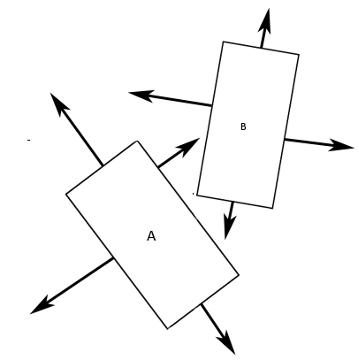
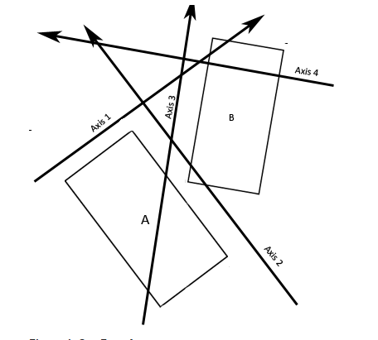
How to do SAT?
Rectangle vs Rectangle
Find all the axis perpendicular to the edges of the object. (Figure 1)
Create axis of projection from all perpendicular axis (Figure 2)
Figure 2. four axes of projection
(picture copied from [2])
Figure 1. eight perpendicular axes
(picture copied from [2]

Slide 9
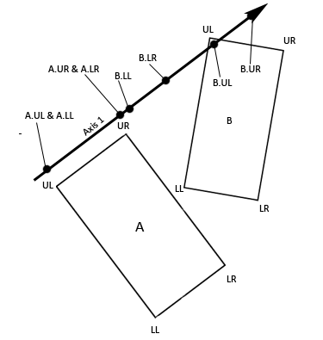
How to do SAT?
Rectangle vs Rectangle
Projection of vectors of rectangles. (Figure 3)
Figure 3. Vectors Projected Onto Axis 1
(picture copied from [2]

Slide 10
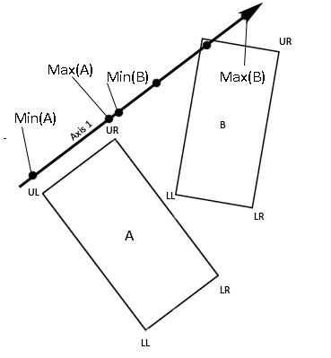
How to do SAT?
Rectangle vs Rectangle
Calculate scalar value of projection and determined its min and max value
Figure 4. The minimum and maximum scalar values
(picture copied from [2]

Slide 11
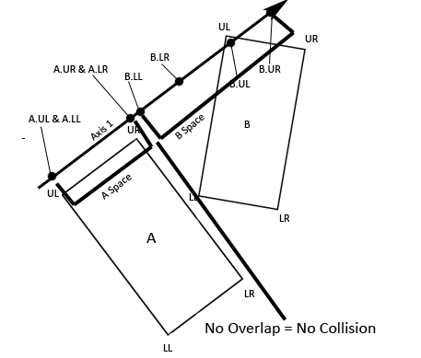
How to do SAT?
Rectangle vs Rectangle
Test for any overlap
Do this for next projection axes. If there is overlap
Figure 5. No overlap No collision
(picture copied from [2]

Slide 12
How to do SAT?
Rectangle vs Circle
Still using the same steps, But a little bit more complex
Since circle has no edge any axis is perpendicular.
But it need one more axis to be tested, the closest point of a polygon to center of circle
Use the concept of Voronoi Region to find closest point.

Slide 13
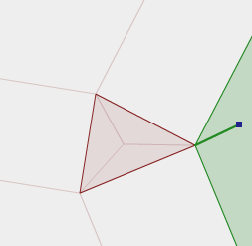
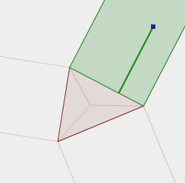
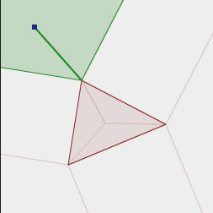
How to do SAT?
Rectangle vs Circle
Voronoi regions (VR) of a polygon are simply the regions in the space around the polygon which contain all of the points closest to a feature of the polygon. [1]
Example:
Figure 6. Vonoroi region for a point and a triangle ( Pictures from [1])

Slide 14
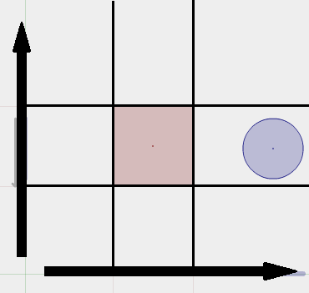
How to do SAT?
Rectangle vs Circle
Find axis of projection and determine vonoroi region

Slide 15
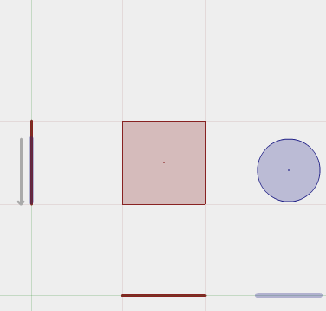
How to do SAT?
Rectangle vs Circle
Project vectors to axis of projection
Find out where the center of circle if it is in which vonoroi region.

Slide 16
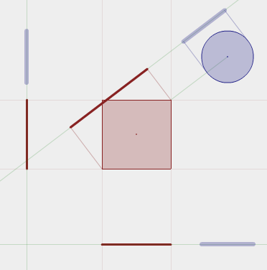
How to do SAT?
Rectangle vs Circle
If it falls into corner VR, it has to calculate and test additional axis.

Slide 17
Refrences
[1] Metanet Software Inc. Collision Detection and Response.http://www.metanetsoftware.com/technique/tutorialA.html
[2] Eric Meythaler . 2D Rotated Rectangle Collision. http://www.gamedev.net/page/resources/_/technical/game-programming/2d-rotated-rectangle-collision-r2604
[3] Kah Shiu Chong. Collision Detection Using the Separating Axis Theorem. http://gamedevelopment.tutsplus.com/tutorials/collision-detection-using-the-separating-axis-theorem--gamedev-169
[4] Eberly, David. Intersection of Convex Objects: The Method of Separating Axes.

